Slide 1
Text2KG – Design Document
By Biswapratap Chatterjee,

Slide 2
High Level Design
Corpus Management Service
Embedding Service
Latent Knowledge Extraction Service
KG Generation Service
Doc2KG Embedding Service
KG Database Service

Slide 3
Corpus Management Service
PDF2Text Service
INPUT
Text Clean Up Service
Line Tokenizing Service
Raw Documents
Direct Text Read Service
Text Rearrangement Service
Pre-embedding Corpus
Abbey Service
OUTPUT

Slide 4
Embedding Service
[ V_{CreditDebit}, V_{ProductPrice}, V_{ProfitLoss}, V_{NameAddress}, etc. ]
OUTPUT 2
[ (Credit, Debit), (Product, Price), (Profit, Loss), (Name, Address), etc. ]
[ V_{Credit} - V_{Debit}, V_{Product} - V_{Price}, V_{Profit} - V_{Loss}, V_{Name} - V_{Address}, etc. ]
Seed Relationships
[ V_{Credit}, V_{Debit}, V_{Product}, V_{Price}, V_{Profit}, V_{Loss}, V_{name}, V_{Address}, etc. ]
Seed Relationship Vectors
Seed Enrichment Services (ex – Synonym addition)
INPUT
OUTPUT 1
Pre-embedding Corpus
Word2Vec Embedding Service
Corpus Vectors
Seed Relationship’s Vector Extraction Service

Slide 5
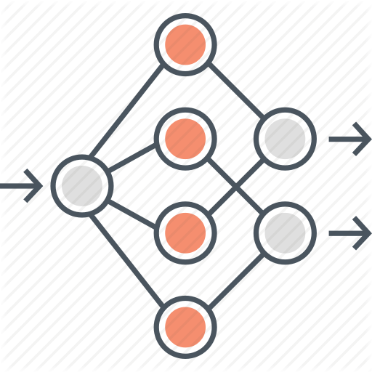

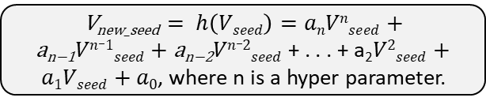

Latent Knowledge Extraction Service
Guided RL Agent
INPUT 1
INPUT 2
V_{new_seed} $= h\left(Vseed\right)=anVnseed+\text{a}\text{n}\text{−1}Vn_1seed+\text{a}\text{n}\text{−2}Vn_2seed$ + . . . + a₂$V2seed+a1Vseed+a0$, where n is a hyper parameter.
Count how many pairs of vectors in the “Corpus Vectors” has a difference “similar” to V_{new_seed}
Corpus Vectors
[ V_{CreditDebit}, V_{ProductPrice}, V_{ProfitLoss}, V_{NameAddress}, etc. ]
OR
$$Vseed$$
V_{new_seed}
New Seed Generator
Stopping Criteria: When the RL agent stops getting any more +ve REWARD counts for “m” epochs, where “m” is a hyper-parameter
Seed Vectors
Count
$$\left(Vseed\right)$$
Learn
ACTOR Deep NN
CRITIC Deep NN
If Count > Threshold
Learn
False
OUTPUT
V_{R} = V_{new_seed :} [List of vector pairs satisfying this relationship]
Predict [a_{n}, a_{n-1}, a_{n-2}. . . a_{2,} a_{1,} a₀]
Predicted REWARD
True
+ve REWARD
-ve REWARD

Slide 6
KG Generation Service
Relationship Vector | Candidate Vector Tuples | Candidate Classes
V_{R1} | [(V_{a1}, V_{b1}), (V_{a2}, V_{b2})] | a → b
V_{R2} | [(V_{a2}, V_{c1}), (V_{a3}, V_{c2})] | a → c
V_{R3} | [(V_{b3}, V_{c2}), (V_{b4}, V_{c3})] | b → c
V_{R4} | [(V_{d1}, V_{e1}), (V_{d3}, V_{e2})] | d → e
V_{R5} | [(V_{b1}, V_{d1}), (V_{b3}, V_{d2})] | b → d
V_{R6} | [(V_{a1}, V_{e1}), (V_{a2}, V_{e2})] | a → e
a | a₁ | a₂ | a₃
V_{R1}
b | b₁ | b₂ | b₃ | b₄
V_{R2}
V_{R3}
V_{R5}
V_{R6}
c | c₁ | c₂ | c₃
d | d₁ | d₂ | d₃
Seed Vectors
V_{R4}
e | e₁ | e₂

Slide 7
Doc2KG Embedding Service
Let’s assume class “a” is product quantity and class “b” is product price. So the KG has discovered 3 quantities (say) 10, 20, 55 from the entire corpus as a₁, a₂, and a₃ respectively and found 2 prices associated with the first two quantities (i.e. a₁ and a₂) from the entire corpus as 50 and 70 as b₁ and b₂ respectively. Now lets assume the class “e” is product name, so e₁ and e₂ can be, (say) PETROL and DIESEL respectively. Now this is a well established KG from the bootstrap corpus.
What happens when a new document arrives into the system?
We embed the new document into this KG.
How?
Continued in next slide . . .
product quantity
a | a₁ | a₂ | a₃
V_{R1}
10
20
55
product price
b | b₁ | b₂ | b₃ | b₄
V_{R2}
50
70
V_{R3}
V_{R5}
V_{R6}
c | c₁ | c₂ | c₃
d | d₁ | d₂ | d₃
V_{R4}
product name
e | e₁ | e₂
PETROL
DIESEL

Slide 8
Doc2KG Embedding Service (continued …)
A ship is carrying 20 kgs of iron ore and is destined for Mumbai. The ship is expected to reach Mumbai on 17th of July 2019. The current market value of iron ore is Rs 150 per kg and this has been settled between the client and the vendor.
Date: 5th July 2019
Place: Singapore.
product quantity
a | a₁ | a₂ | a₃ | 20
V_{R1}
10
20
55
product price
b | b₁ | b₂ | b₃ | b₄ | ₁₅₀
V_{R2}
50
70
V_{R3}
Assume, the above is the new document that has just arrived into the system. First, we will vectorize the entire corpus again with this document added into the corpus. Then, if we apply V_{R1} to the new vectorized document we will (according to hypothesis) find the two n-grams “20” and “150” as two candidates satisfying V_{R1}. Similarly, if we apply V_{R6} then we will find “20” and “IRON ORE” as two candidates satisfying V_{R6}. Now just take this information and embed it into the existing KG.
V_{R5}
V_{R6}
c | c₁ | c₂ | c₃
d | d₁ | d₂ | d₃
V_{R4}
product name
e | e₁ | e₂ | _{IRON ORE}
PETROL
DIESEL

Slide 9
KG Database Service
Although, the output of the entire product is the KG, but as you can see it obviously can not be directly used by the end customer.
Therefore, a Database Service needs to be built and wrapped around the KG for ease of usage. The DB service will treat the KG as its persistent storage and will have a query language very similar to SQL. Below are few sample queries –
SELECT “product price” WHERE “product quantity” IS > 15
Answer: 70
SELECT “product price” and “product name” WHERE “product quantity” IS > 15
Answer: 70, PETROL
product quantity
a | a₁ | a₂ | a₃ | 20
V_{R1}
10
20
55
product price
b | b₁ | b₂ | b₃ | b₄ | ₁₅₀
V_{R2}
50
70
V_{R3}
V_{R5}
V_{R6}
c | c₁ | c₂ | c₃
d | d₁ | d₂ | d₃
V_{R4}
product name
e | e₁ | e₂ | _{IRON ORE}
PETROL
DIESEL

